Slide 1

Civil drawing
Name | ID
MIR MONJUR MORSHED | 19-40913-2
MD. HASIN ARMAN FAHIM | 19-40686-1

Slide 2
What is Civil drawing?
A civil drawing, or site drawing, is a type of technical drawing that shows information about grading, landscaping, or other site details.
Examples of civil engineering projects are houses, bridges, building sites, canals etc.

Slide 3
What is BNBC Rule?
The BNBC is a guideline for proper construction practices.
Published in 1993
Regulate the construction of buildings and maintain and uphold them to certain standards.

Slide 4
Software can be use for civil drawing
1982 AutoCAD V1.0 (DOS version)
1987 AutoCAD Release 9 (new naming style)
1992 AutoCAD Release 12 (windows version)
2000 AutoCAD 2000
AutoCAD 2006,
AutoCAD 2007…

Slide 5
How to start CAD
Double click the AutoCAD 2007 icon, or
Start – Programs - AUTOCAD 2007, or
Open a previously saved drawing

Slide 6
AutoCAD options used for drawing
Draw
Dimension
Modify
Design center
Properties
Pan
Zoom
File
Ortho
Osnap

Slide 7
Component use from “Draw” option
Line
Rectangle
Circle
2 points
Text
Multiline text

Slide 8
Component use from “Dimension”, “Modify” & “Properties” option
Dimension
Linear
Modify
Offset
Move
Linetype
By layer
ACAD_ISO02W100
Text size
15.0000
10.0000
22.0000
25.0000

Slide 9
Description of the Civil drawing layout
Bedroom 1 & 2(10’ * 14’7”)
Bedroom 3 (12’ * 20’)
Toilet 1 & 2 (8’ * 8’)
Toilet 3 (5’ * 12’)
Utility (8’ * 8’)
Drawing room (13’ * 25’)
Kitchen (8’ * 19’7”)
Lift (7’6” * 6’10”)
Store room (6’ * 6’)
Lobby
Stairs
Empty places

Slide 10
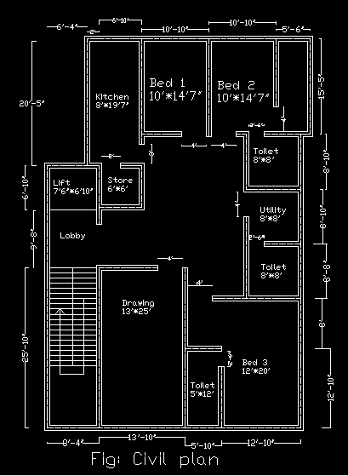
Sample of Civil Drawing

Slide 11
Instructions for civil drawing with electrical fittings
First of all, place all the Switchboards (SB) accordingly
Provide sufficient number of lights and fans for each room. If the room is fairly large then provide multiple fans, lights and even multiple SBs.
Every toilet and kitchen should have exhaust fans. Select suitable places for exhaust fans.
Provide sufficient number of switched socket outlets on both SBs and distant from the SBs. Each SB around the living rooms should have at least one socket outlet. Kitchens may have a distant socket for wall mounted fans, toilets should have distant socket for electric razors, hair driers etc.
Each living room should have distant switched socket at skirting level for TV with cable TV connectivity.
Fair amount of telephone connectivity options should be allocated.
Calling Bell (CB) position should be wisely chosen. It should be placed near the common place and distant from the bedroom (if possible).
SDB and MDB positioning should be wise. MDB needs to be monitored by the meter- readers so, it should be placed in an easily accessible place where sufficient lighting arrangement is ensured.
The symbols to be used for Fittings and Fixture Layout are rather flexible. You can define your own symbols. You must also attach the ‘Legend’ which would suggest the meanings that your symbols carry.

Slide 12
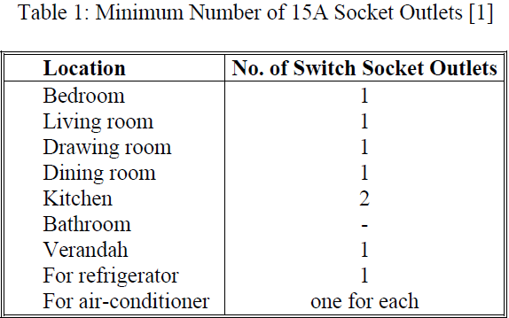
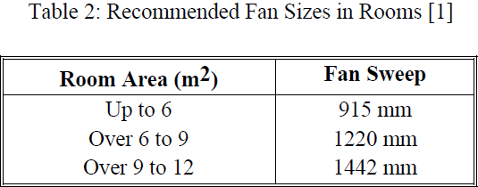
Codes
For residential occupancy, the minimal guidelines given in Table 1 shall be used to determine the required number of 15 A switch socket outlets, when actual requirements cannot be ascertained.
Table 2 gives the recommended areas to be served by different sizes of ceiling fans where the height of fan blades is at 2.5 m above the finished floor level.

Slide 13
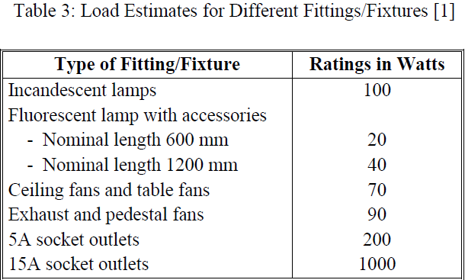
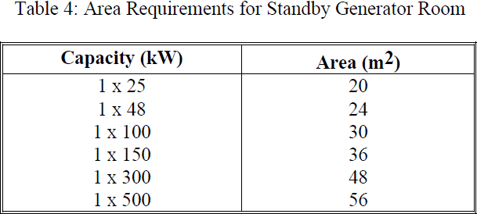
Codes
In estimating the electrical load, the ratings shown in Table 3 shall be taken unless actual values are known or specified.
Table 4 shows minimum generator room area requirements for different sizes of generators.

Slide 14
The symbols to be used for Fittings and Fixture Layout
F– Fan
L – Light
T – Tube Light
K – One Kind of Light
TV – Television
TE – Telephone
M – Motor
CH – Hanging Light
ML – Multiple Light
CB – Circuit Breaker
SB – Swich Board
SS – Swich Board Socket
ST – Two Pin Socket
SL – Skirting Level Socket
TS – TV Socket
15_1 – 3 Pin Socket (15 A)
TJB – Telephone Junction Board;
AJB – Antenna Junction Board
C1, C2…. – No of Cables;
1,2,3……… - no of SB
SDB – Sub Distribution Board,
MDB – Main Distribution Board

Slide 15
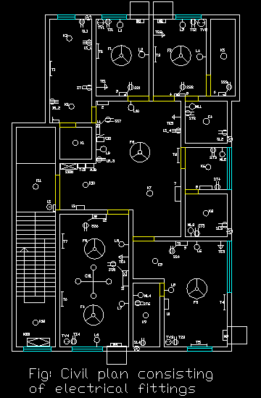
Sample of Civil drawing with electrical fittings

Slide 16
Conclusion
Interpret the results and determine the extent to which the experiment succeeds in adhering to the initially set goals. Learn how you can improve any mistakes or investigations you may make during the design process.

Slide 17
Thank You

